Slide 1
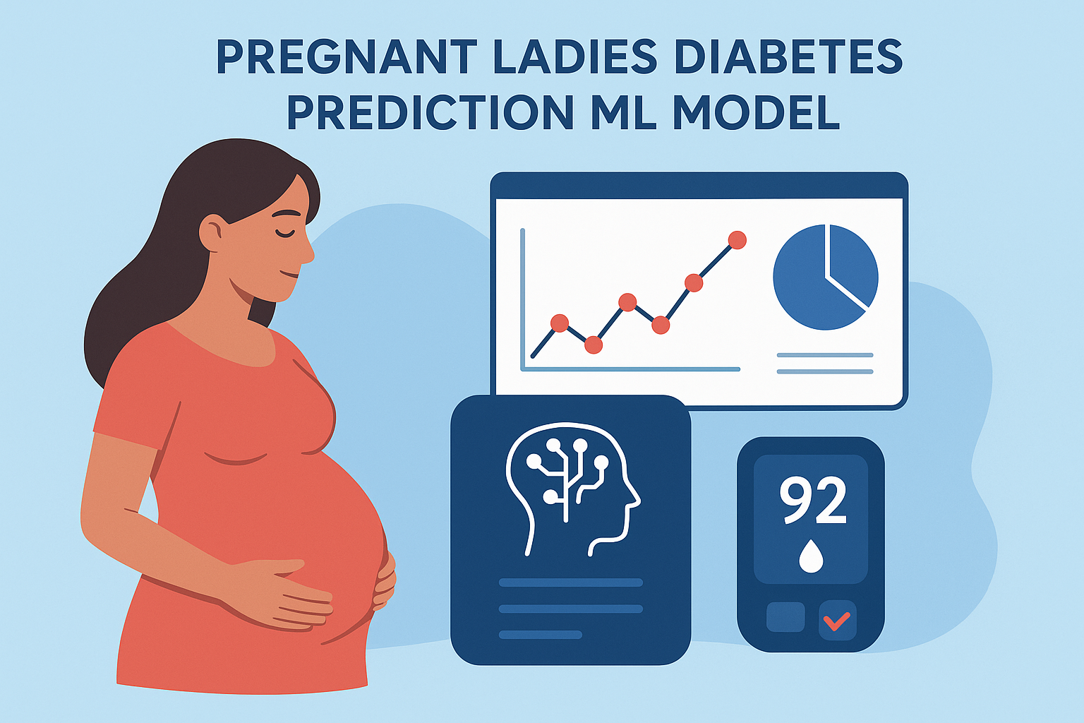

Slide 2
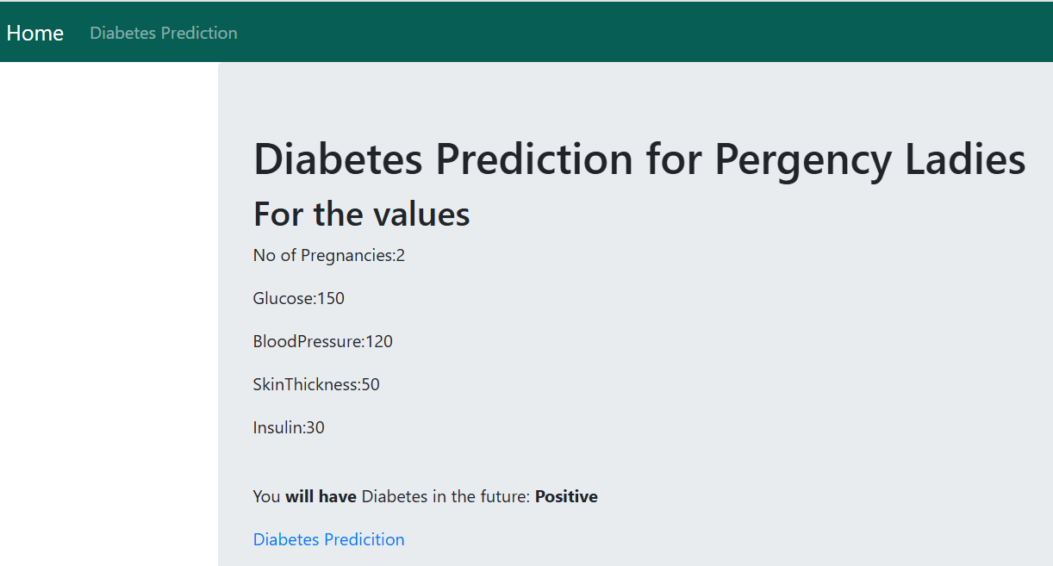

Slide 3

Develop a machine learning model to accurately predict diabetes range and prevent abnormal circumstances for pregnant women.

Slide 4
Tools and Methods
Python, Pandas, Scikit-Learn, Matplotlib, Seaborn
Models
SVC, Decision Tree, Random Forest, Logistic Regression, KNN, Gaussian NB, Bernoulli NB
Feature Selection
SelectKBest (chi2)
Evaluation
Accuracy, Confusion Matrix, ROC-AUC
Model Optimization
GridSearchCV for hyperparameter tuning

Slide 5
Model Comparison
Algorithm | Accuracy
SVC | 0.78
Decision Tree | 0.75
Random Forest | 0.77
Logistic Regression | 0.78
KNN | 0.72
Gaussian NB | 0.76
Bernoulli NB | 0.73

Slide 6
Best Model
Based on accuracy scores, all models are performed average. Among them, SVC with tuned parameters using GridSearchCV (Linear Kernel) emerged as the best performing model.
Deployment Workflow
Model Trained and saved using pickle
User input standardized for predict the Diabetes range
Integrated with Django as a Web-Based Prediction application

Slide 7
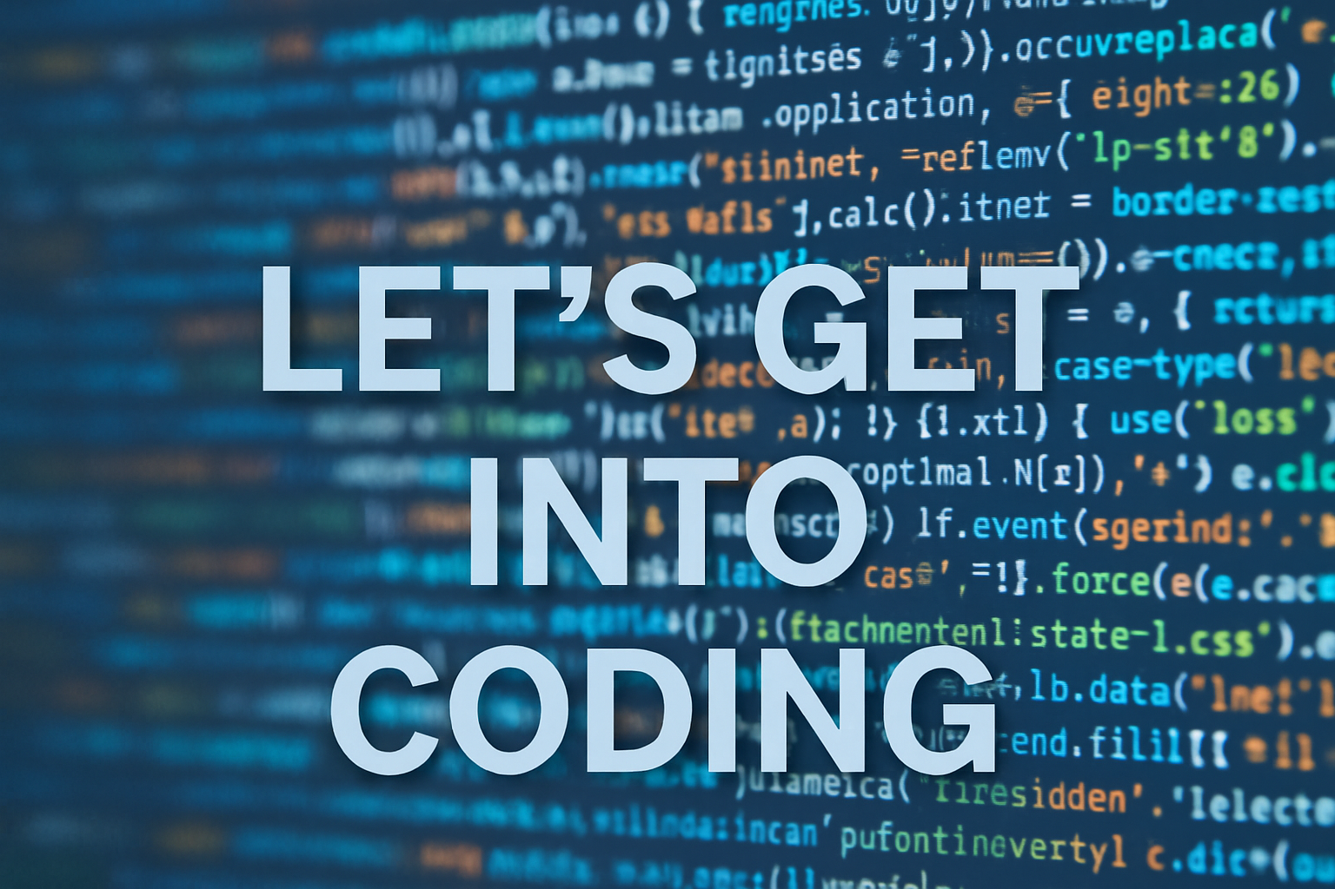

Slide 8
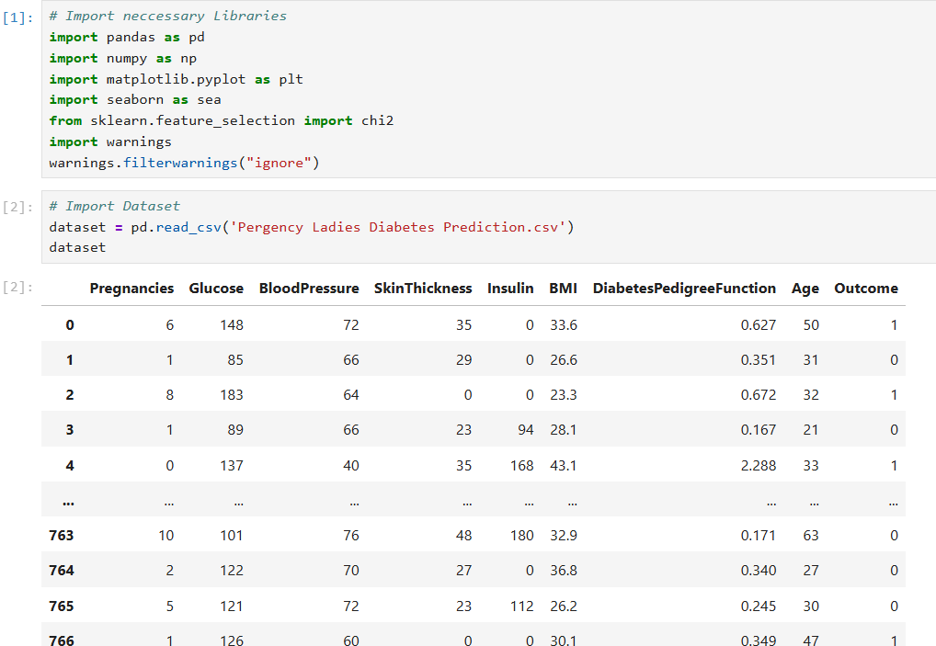
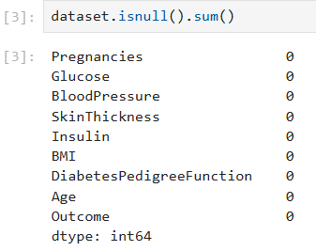
Data Preprocessing

Slide 9
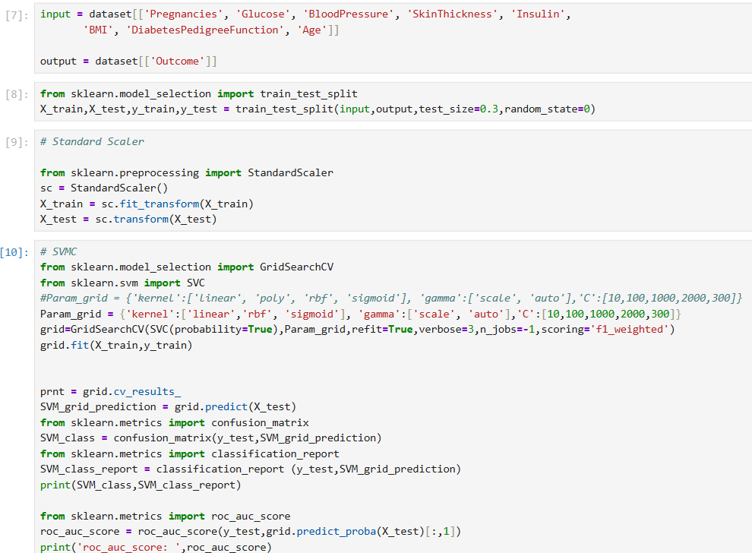
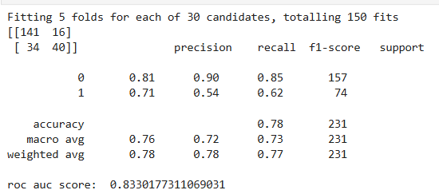
Best Algorithm Selection

Slide 10
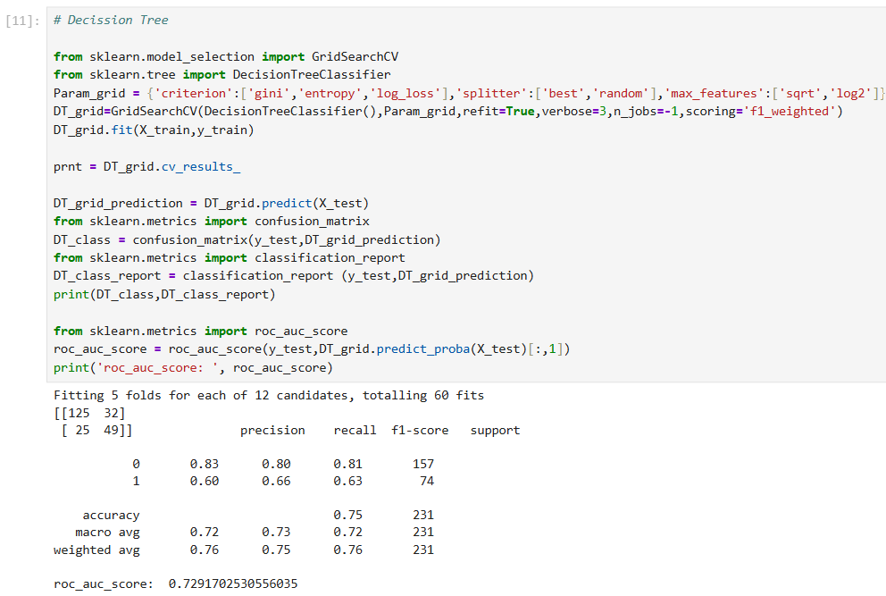

Slide 11
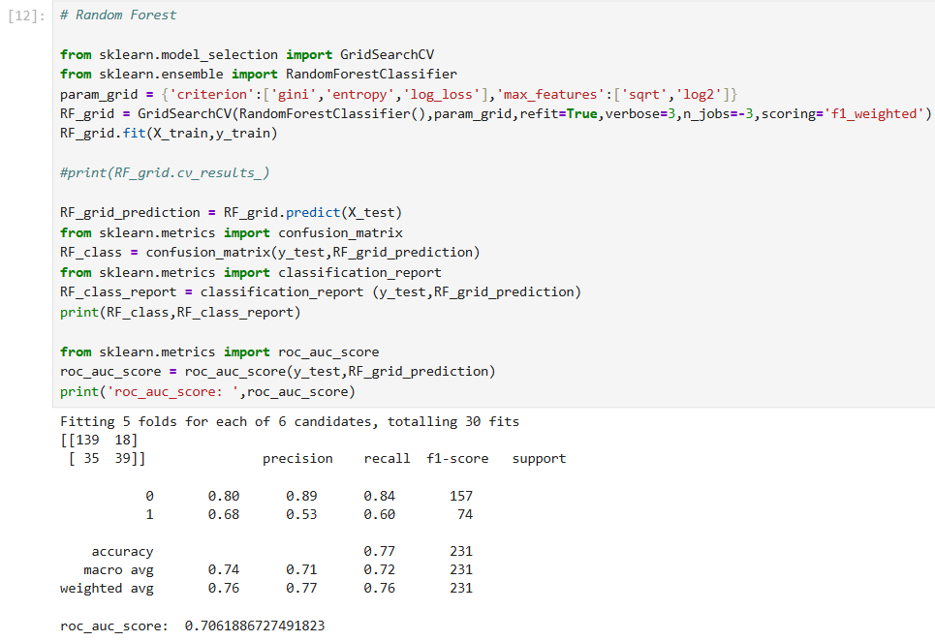

Slide 12
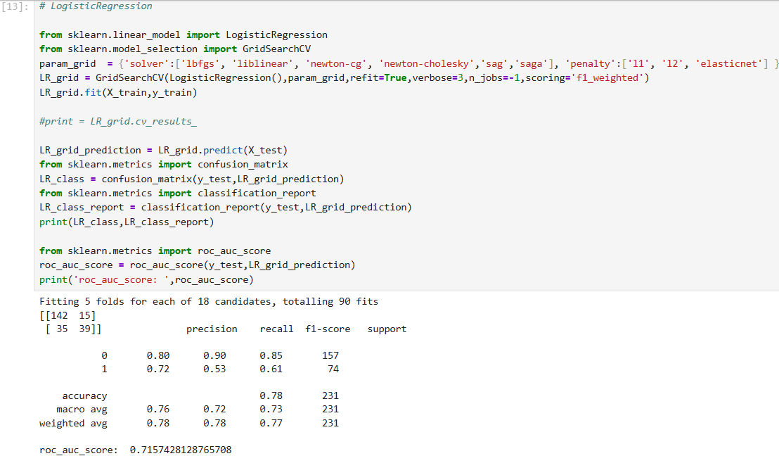

Slide 13
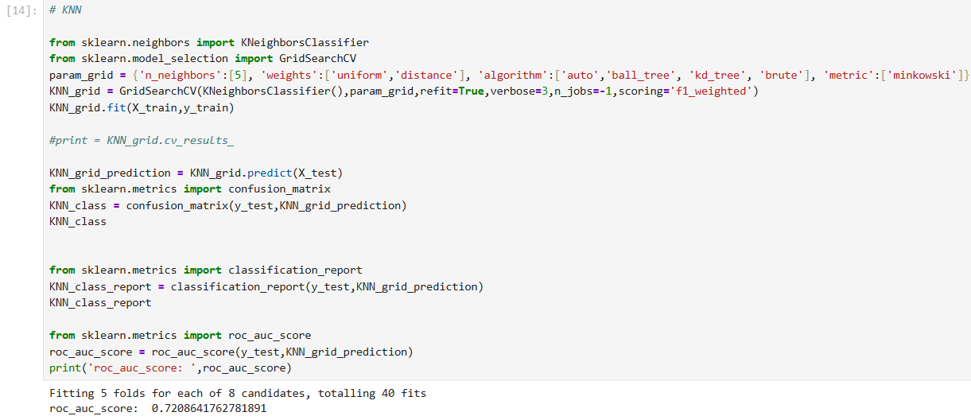

Slide 14
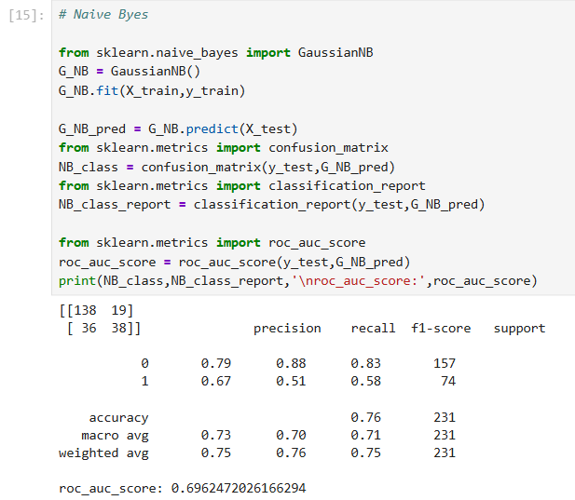
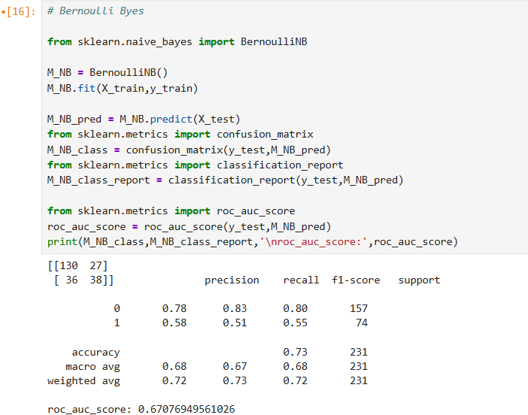

Slide 15
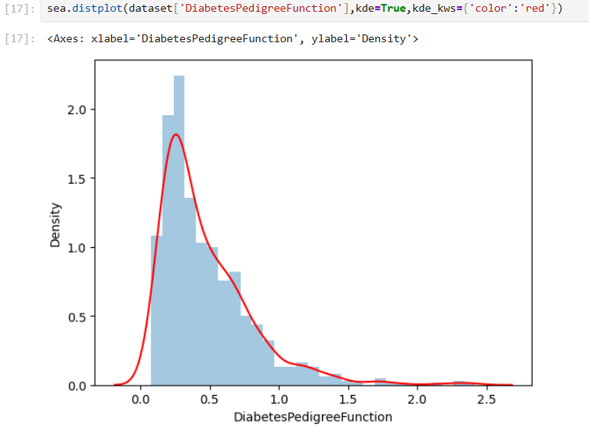
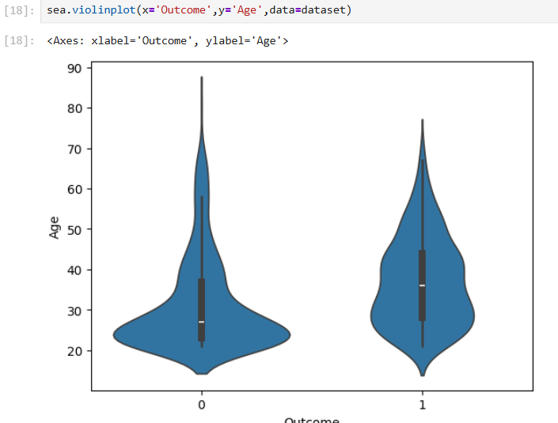
Data Analysis

Slide 16
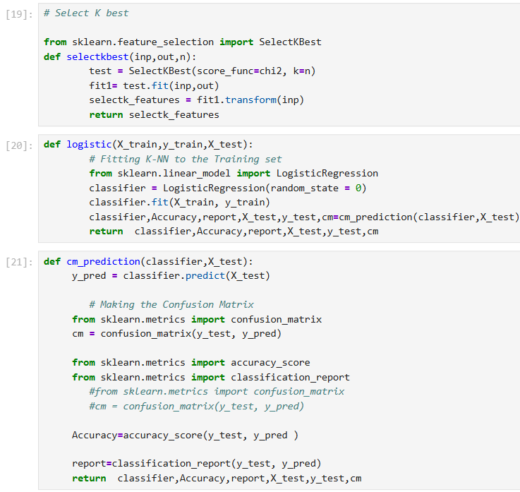
Feature Selection

Slide 17
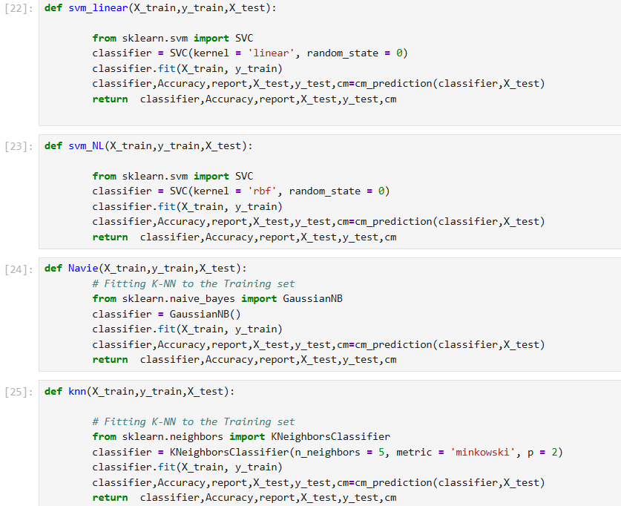

Slide 18
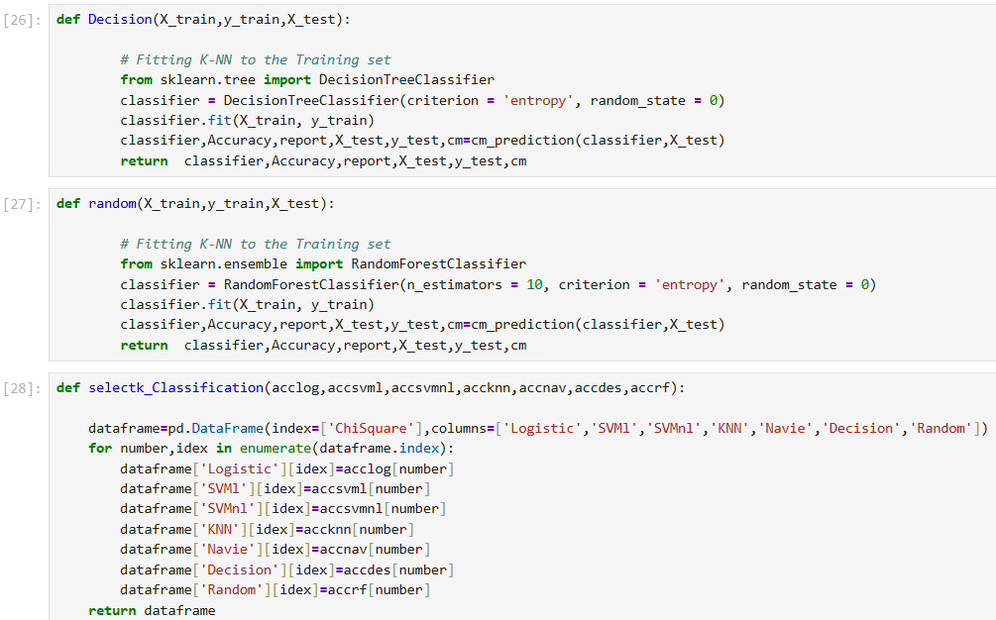
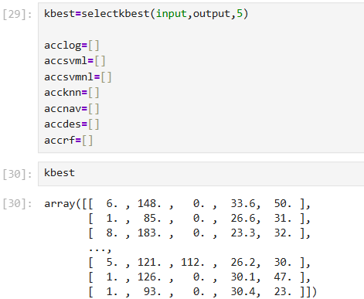

Slide 19
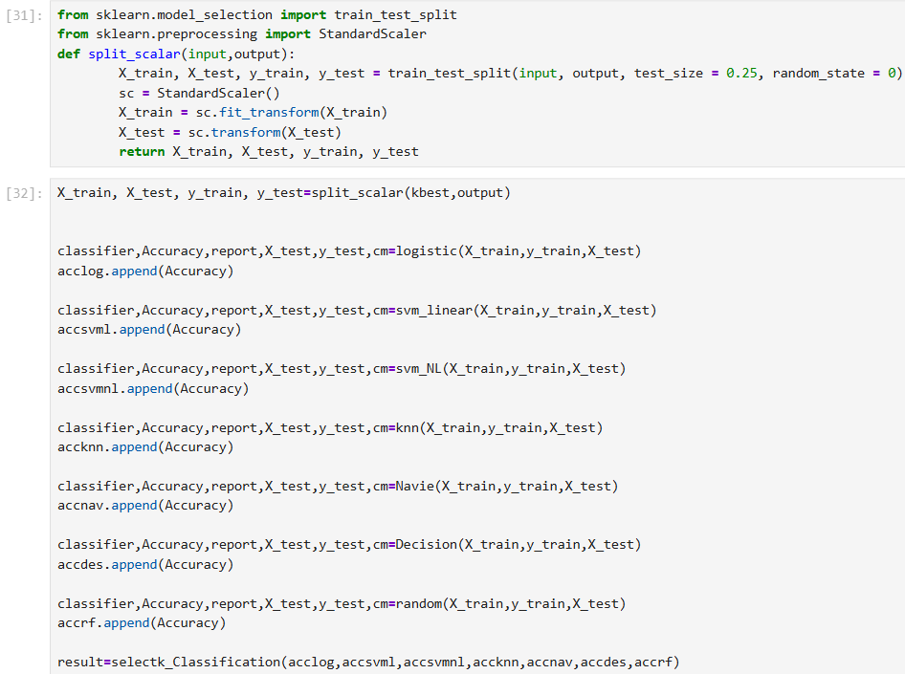
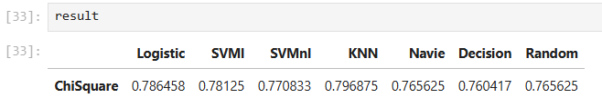

Slide 20
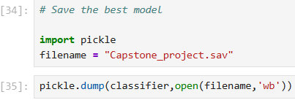
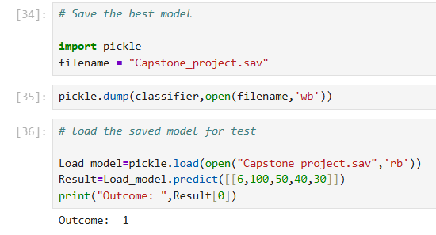
Save the best model
Deployment Phase

Slide 21

Follow me on www.linkedin.com/in/venkadesh-s-56400b32a

